Slide 1
Concurrent tasks. Futures

Slide 2
contents
Concurrent tasks
Futures and Promises
Brief comparisons:
Concurrent vs Parallel
Futures vs Promises

Slide 3
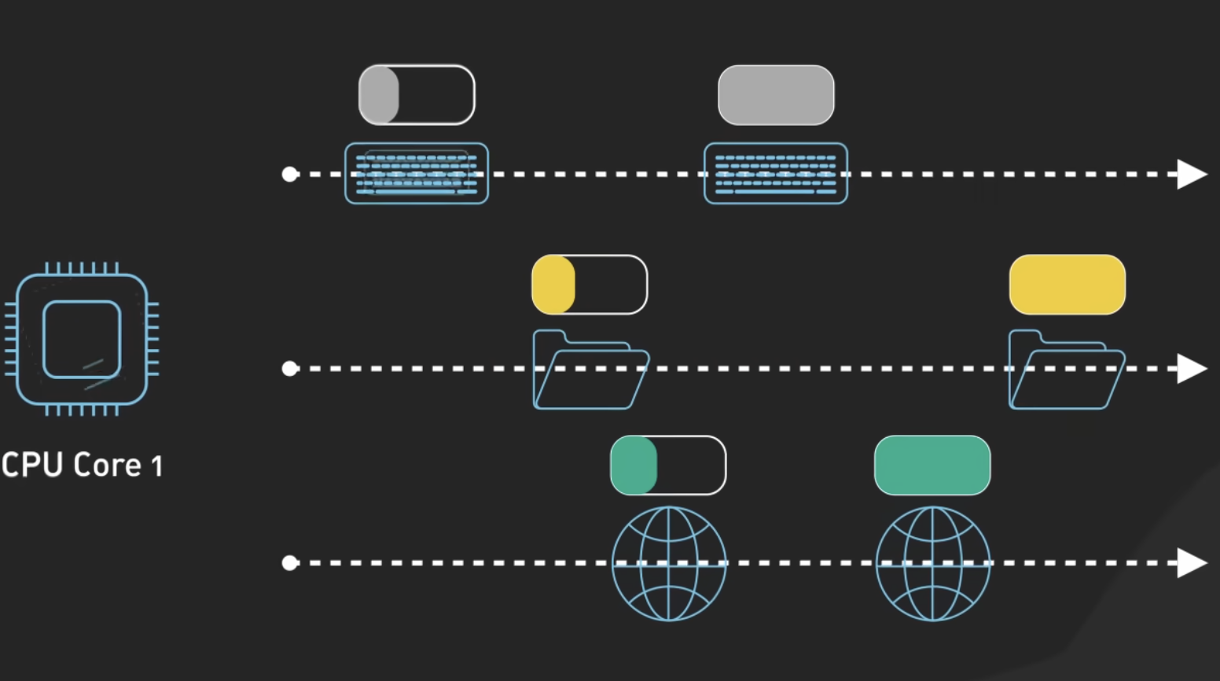
Concurrent tasks

Slide 4
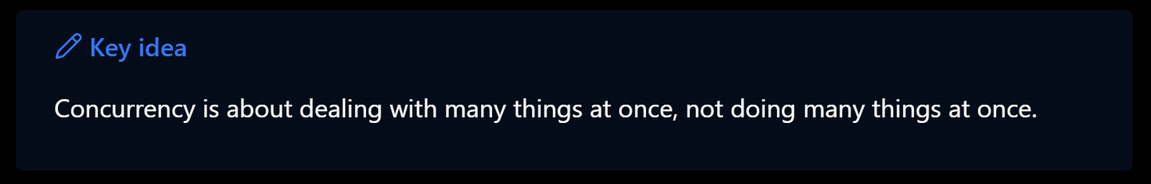
What Are Concurrent Tasks?
Concurrency = multiple tasks making progress at the same time
Tasks share the same CPU, switching between them rapidly
Focus: structure and responsiveness, not simultaneous execution
Often used for I/O-bound operations
Notes:
Concurrency is about **dealing with many tasks at once**, not necessarily executing them simultaneously. The CPU switches quickly between tasks working on each one for short periods of time — this is called **context switching**

Slide 5
How Concurrent Tasks Work?
Managed via threads or async tasks
CPU performs context switching between tasks
Each task maintains its own state
Overhead: saving/restoring state
Notes:
Each concurrent task runs in its own thread or asynchronous context. The CPU jumps between them, saving and restoring their states — that’s **context switching** - which creates the illusion that the tasks progress simultaneously , though they are not. Context Switching comes with overhead, CPU must save and restore each task, which takes time. Excessive Content Switching can cause poor performance.Example: one chef makes a couple of dishes and keep alternating between them

Slide 6
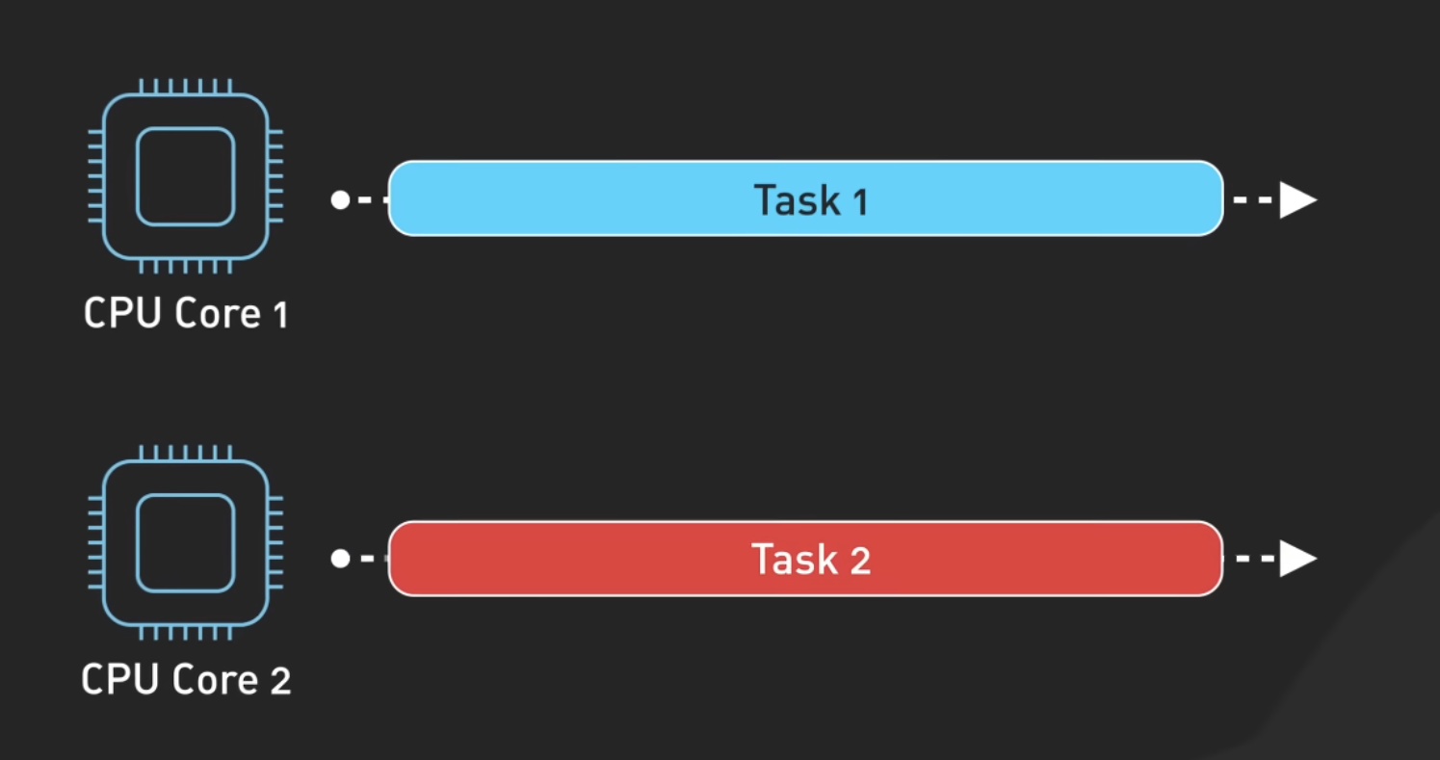
What are parallel Tasks?
Parallelism = multiple tasks executing at the same time
Requires multiple CPU cores
Focus: performance and speed
Ideal for CPU-bound computations
Notes:
Parallelism is when multiple tasks truly run **at the same time** — each on a different core. The main goal is **speeding up heavy computations** by splitting work into independent subtasks.

Slide 7
How Parallel Tasks Work?
Tasks are divided into independent subtasks
Each core executes one subtask
Combines results for final output
Common in data analysis, rendering, ML training
Notes:
The program divides a big job into smaller ones that can run simultaneously. Each subtask runs on a separate core, and then results are combined. Think of it as having multiple workers doing different parts of a job at the same time.

Slide 8
Quick Comparison
Feature | Concurrency | Parallelism
Meaning | Managing multiple tasks | Executing multiple tasks simultaneously
CPU cores | 1 or more | 2 or more
Goal | Responsiveness | Performance
Ideal for | I/O-bound tasks | CPU-bound tasks
Usage | Web Servers; GUI Responsiveness; I/O-heavy apps | Scientific simulations; Video or Image rendering; Machine Learning
Notes:
Concurrency shines when many operations wait on external resources — like user input or APIs. Parallelism shines when you can divide a computation-heavy task into independent parts. The best systems often use **both**, depending on the workload type.

Slide 9
Recap
Concurrency → handles many tasks efficiently
Parallelism → executes many tasks simultaneously
Both improve system performance and scalability
Together, they build responsive and powerful software
Notes:
To sum up — concurrency and parallelism are not the same, but they work hand-in-hand.

Slide 10
Futures and promises

Slide 11
Why Futures and promises?
Enable asynchronous and non-blocking computation
Simplify thread communication
Avoid low-level synchronization tools (like locks or mutexes)
Improve performance and responsiveness
Notes:
These abstractions let programs perform time-consuming operations — like file access or network calls — without freezing the main thread. They remove the complexity of using synchronization primitives directly.

Slide 12
Terminology:Futures
class template object
a read only object containing data
the data may not be available or computed in the present
data is promised to be available to you in the future
get() method is the main purpose of a future object
calling this method will block until the data is available
returns a value or throws an exception
Notes:
A future is a read-only object that represents a value which will become available later. You access the result through the `get()` method — it waits if the computation isn’t done, and throws an exception if it failed. A future acts like a “receipt” for a computation — you don’t have the result yet, but you know it’s coming.

Slide 13
Terminology: Promises
class template object
promise object has an associated future object
which is automatically instantiated when a promise is created
the only public constructor for a future object creates an empty or invalid future
promise object guarantees it will take "the value returned" by the function and place in the future object at some point in time
Notes:
A promise is the write side of the mechanism. When you create a promise, it comes with a future. Another thread or function uses the promise to provide the result — fulfilling it makes the future’s value available. A promise guarantees that some computation will eventually provide a value. You can think of the promise as the “supplier” and the future as the “receiver.”

Slide 14
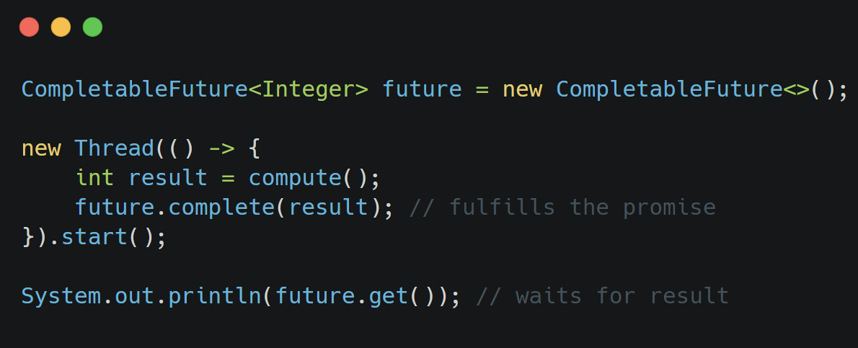
How do they Work Together?
A Promise is created.
It automatically generates an associated Future.
The Promise is passed to a worker thread or async function.
The worker sets the result on the Promise.
The Future becomes ready, and get() retrieves the value.
Notes:
The main thread holds the future, while a worker thread completes the promise. When the worker calls `complete()`, the value becomes available for `get()`.

Slide 15
When to Use Futures and Promises
Use Them When:
Tasks take time but can run independently
You need to continue other work while waiting for results
Working with I/O, network calls, or database queries
Combining results from multiple concurrent computations
Notes:
Futures are perfect for background tasks. For instance, in a text editor — load the rest of the file while the user edits the first part.

Slide 16
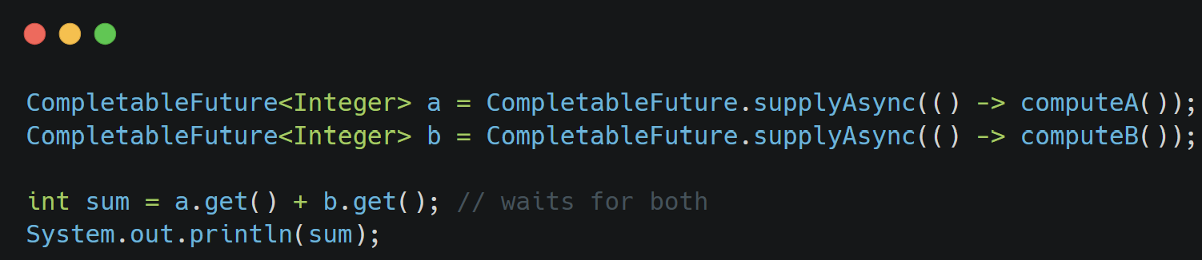
Example: Parallel Computation
Run multiple independent computations and combine results.
Notes:
Each computation runs in its own thread. The main thread only waits when combining results. This structure improves performance for CPU-intensive or I/O-bound operations

Slide 17
Exception Handling
If the computation fails, the Future holds an exception
get() throws the exception when called
A broken promise occurs if a promise is never fulfilled
In Java, use completeExceptionally() to handle failures
Notes:
When a thread fails, exceptions can be passed through the promise to the future, allowing structured error propagation rather than raw thread exceptions.

Slide 18
Benefits
Concept | Description | Example (Java)
Future | Read-only placeholder for a value | Future<Integer> f = executor.submit(...)
Promise | Write-end used to fulfill the value | CompletableFuture.complete()
Async | High-level abstraction managing both | CompletableFuture.supplyAsync(...)
Improved responsiveness and resource usage
Cleaner asynchronous code without manual synchronization
Built-in error propagation and result handling
Encourages modular and composable design
Notes:
These abstractions simplify concurrent programming. They keep code readable and structured, while allowing efficient use of system resources. Futures are about retrieving data; promises are about supplying it. Async tools combine both concepts and automate the process.

Slide 19
Recap
Future = placeholder for an upcoming result
Promise = the mechanism that provides the result
Together, they enable asynchronous, safe, and scalable programming
Use them for long-running or parallelizable operations
Notes:
Futures and promises help manage asynchronous tasks elegantly. They turn multithreaded communication into a structured and predictable process — vital for modern concurrent systems.

Slide 20
Brief Comparison
 | Description | Analogy
Concurrent Tasks | Multiple tasks progressing during overlapping times | Like multitasking one CPU core
Parallel Tasks | Multiple tasks executed truly at the same time on multiple cores | Like several people working simultaneously
Futures | Placeholder for a result of an asynchronous computation | Like a receipt for an order
Promises | The write-end that fulfills or rejects a future | Like the chef who prepares the meal

Slide 21
Summary
Concurrent Tasks: enable progress of multiple operations without simultaneous execution
Futures: represent results of asynchronous computations
Both improve efficiency, responsiveness, and maintainability in modern systems

Slide 22

Thank YOu

